Slide 1
Analyzing the American Electorate
Josh You

Slide 2
Introduction
This project seeks to determine how Americans are clustered in their political views, and along which features those clusters are divided.

Slide 3
Dataset
The Cooperative Congressional Election survey, conducted annually as a collaborative project between universities around the US
The 2016 survey had 64,600 respondents
Around 500 questions, including how they voted for various races, their demographics (e.g. race, income, gender, religion), their opinions on various political issues.

Slide 4
Data Cleaning
Selected a subset of columns of interest, due to the high number of total columns
Restricted rows to those who answered the post-election survey
Imputed missing values with the modal response for a few questions where most people chose one option
Converted categorical variables to binary dummy variables, while collapsing the number of categories to reduce the total number of columns
48,144 data points and 129 columns remained

Slide 5
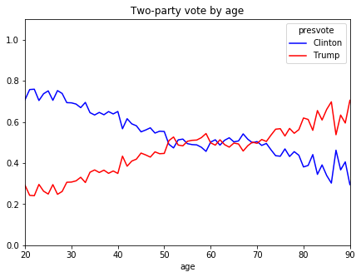
Exploratory Data Analysis – vote by age

Slide 6
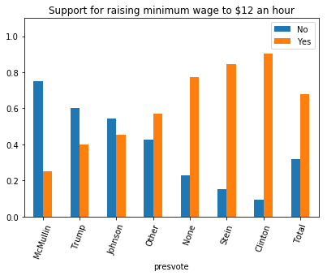
EDA – views on minimum wage by vote

Slide 7
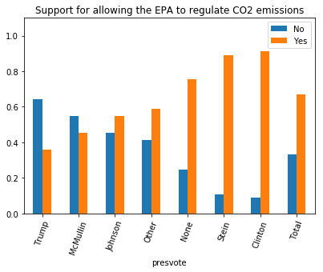
EDA – support for EPA regulating CO2

Slide 8
EDA - summary
Overall, voters mostly agree with the views of the candidate and party they support.
Third party voters (e.g. Stein, McMullin, Johnson voters) may be more moderate than the candidates themselves
Non-voters are perhaps more similar to Democrats than Republicans

Slide 9
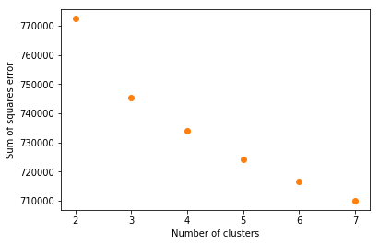
Clustering
Used k-means to cluster data, chose k = 5

Slide 10
Cluster classification
Supervised learning to predict cluster label shows which features best predict cluster label, and therefore how the clusters are divided.
Random forest model achieved 84% cross-validated accuracy
Logistic regression achieved 90% cross-validated accuracy

Slide 11
Feature importance
Most important features in the random forest model included presidential vote, supporting for repealing ACA, support for EPA regulating CO2, important of religion, agreement with the view that white people have an advantage in the US, and raising the minimum wage

Slide 12
Logistic Regression coefficients
The feature with the highest coefficient (in absolute value) for each cluster:
Cluster 0: Born-again Christian
Cluster 1: Voted for Evan McMullin
Cluster 2: Opposes allowing EPA to regulate CO2
Cluster 3: Opposes repealing the ACA
Cluster 4: Views religion as very important in their life

Slide 13
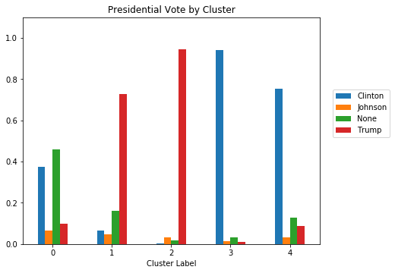
EDA for clusters – presidential vote

Slide 14
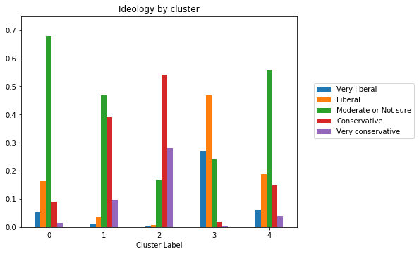
Cluster EDA - Ideology

Slide 15
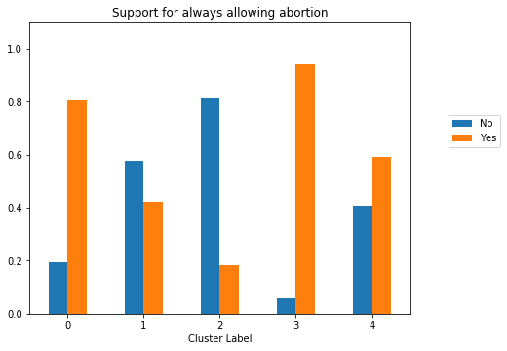
Cluster EDA – allow abortion

Slide 16
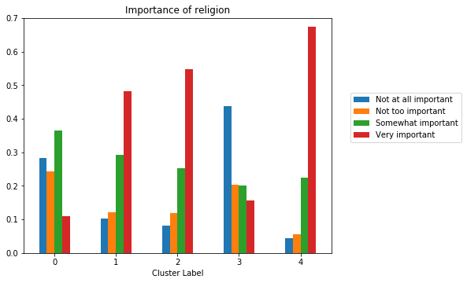
Cluster EDA – important of religion

Slide 17
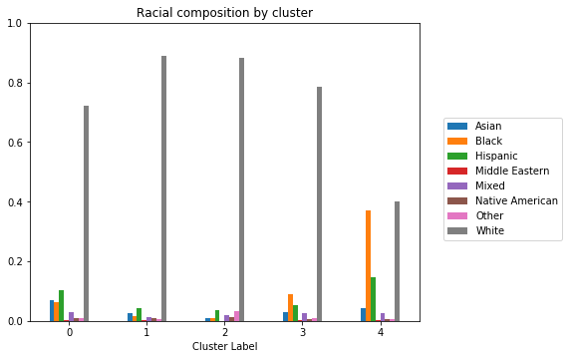
Cluster EDA - Race

Slide 18
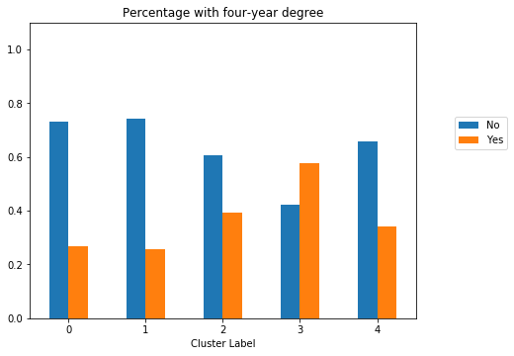
Cluster EDA – four year degree

Slide 19
Summary
Two clusters that are largely Clinton voters, two that are largely Trump, one with lots of non-voters, rest mostly Clinton voters
Two Clinton clusters divided along education, religiosity, race, ideology. One cluster is more educated, more white, more liberal, less religious than the other
Trump clusters divided along education and ideology. One is more educated and more conservative than the other

Slide 20
Recommendations
Campaigns should recognize correlations between issues and demographics
More educated voters are more ideological
Minority Clinton voters are more religious and less liberal than white Clinton voters
The typical non-voter is more similar to Clinton voters and has views closer to the Democratic party than the Republican party

